Slide 1
CS534 Spring 2019
Project Part I
Presentation by: Yichen Li, Jiayi Li
Notes:
We are showcase for Adversarial Search and Game Playing
We are …, …
*Don’t mention all the names we will put in for showcasing work by: ….

Slide 2
Introduction
Using Python
Trying to make project more adaptable

Slide 3
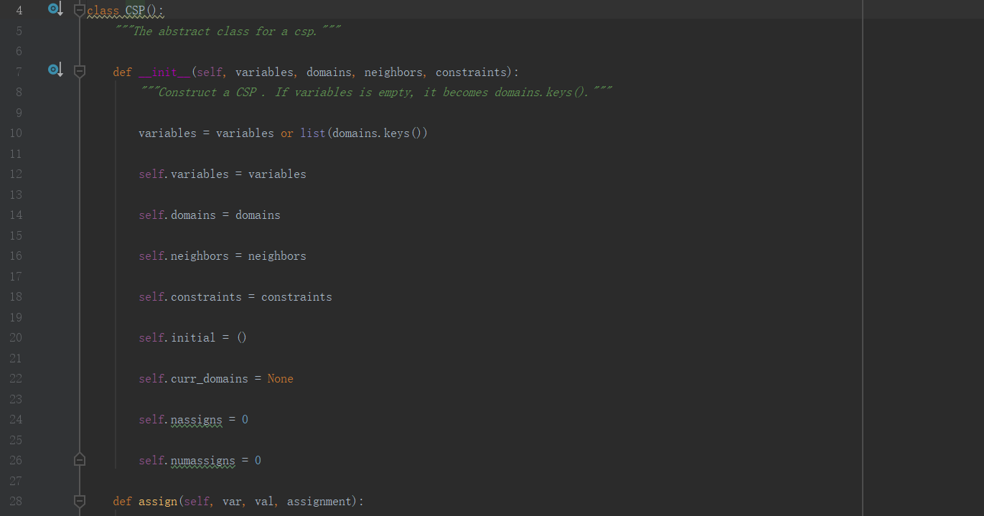
CSP class
The core class of part 1
Suitable for most CSP problem

Slide 4
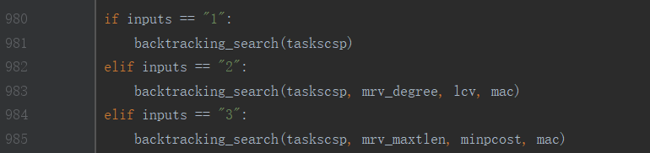
Uncoupled Heuristic function
The Heuristic function is uncoupled with CSP class
You could define your own Heuristic function without changing other part of code
Such as the Optional problem

Slide 5
Optional Part
Changing the Heuristic function to length of task and cost of processor

Slide 6
Thank you!
Questions
Notes:
*End here, last slide

Slide 7
Backup Slides

